Slide 1

Chemical registers, legal compliance, SDSs and RiskAssess
James Crisp and Phillip Crisp

Slide 2
What are the legal requirements?

Slide 3
Hazardous chemicals register
A person conducting a business or undertaking at a workplace must ensure that —
(a) a register of hazardous chemicals used, handled or stored at the workplace is prepared and kept at the workplace; and
(b) the register is maintained to ensure the information in the register is up to date.
. . . . . . .
The register must include —
(a) a list of hazardous chemicals used, handled or stored; and
(b) the current safety data sheet for each hazardous chemical listed.
. . . . . . .
The person must ensure that the register is readily accessible . . .
Work Health and Safety (General) Regulations 2022, 346 (a)-(c)

Slide 4
What are hazardous chemicals?
The WHS Regulations* reference the GHS definition of a hazardous chemical.
The GHS defines a chemical as hazardous if it meets the definition of one or more physical, health or environmental hazard classes.
WA Workplace regulations exclude substances that are only ecotoxic from register requirements.
RiskAssess follows the GHS definition exactly:
Hazardous = has a signal word
* Work Health and Safety (General) Regulations 2022, Schedule 9 (1)

Slide 5
Placarding & Manifest quantities
Large quantities of chemicals require warning signage (placarding).
Even larger quantities require information to be lodged with emergency services and WorkSafe (manifest)
Examples:
flammable liquids (Class 3, PG II, e.g. ethanol, acetone)
placard at 1,000 L, manifest at 10,000 L
Corrosives (Class 8, PG II, e.g. sulfuric acid)
placard at 1,000 L, manifest at 10,000 L
School science lab quantities usually well below cut offs
(Exception: LPG gas for school)

Slide 6
Safety Data Sheets
SDS from the manufacturer/supplier must be “available” wherever a chemical is stored or used.
Only a court of law can decide “available”
SDS valid for 5 years.
Monitor expiry date and replace with new SDS.
No specification of SDS medium.
Paper or electronic format ok, if “available”.
Backup needed.
What if old chemical with no current SDS?

Slide 7
What further features would be helpful?

Slide 8
Chemical inventory
No legal requirements
You can arrange your inventory as you wish!
Include whatever details you wish!
However:
If basis for the chemical register, it must include
• name of each hazardous chemical stored
• current safety data sheet for each chemical
If it is to assist emergency services, it must include
• quantities of chemicals
• storage locations

Slide 9
We decided to differentiate between…
Inventory | Register
School staff | Emergency services
All chemicals | Hazardous chemicals
All data, SDS | Totals by DG Class, Selected data & SDS
Needs login | Accessible via QR Code
Editable | Read-only Automatic from Inventory

Slide 10
QR Codes
Emergency services want to know rapidly the nature and quantities of dangerous goods stored, especially flammable liquids and gas cylinders.
Only interested in total quantities of Dangerous Goods in each Class.
E.g. total Class 3 Flammable Liquids
A QR code allowing access to the chemical register from a mobile phone is the ideal.

Slide 11
Stocktaking on phone
Regular stocktaking of chemicals is necessary.
Essential to keep chemical register up to date.
Best to keep chemical inventory up to date.
Automatic update of chemical register from inventory possible electronically.
Stocktaking using mobile phone possible electronically.

Slide 12
Chemical storage
Safe systems for chemical storage are central to chemical management in the chemical store, prep room and laboratory.
Guidance is available from many sources, usually not specific to schools.
RiskAssess provides a simple guide.

Slide 13
Linkage to chemical data
Easy access to SDSs and chemical data from the chemical register and chemical inventory is desirable.
Essential to have linkage from chemical register to SDSs.
Possible to connect chemical inventory, chemical register, SDSs, chemical data and stocktaking into a holistic system using computer and phone.
RiskAssess has done this!

Slide 14
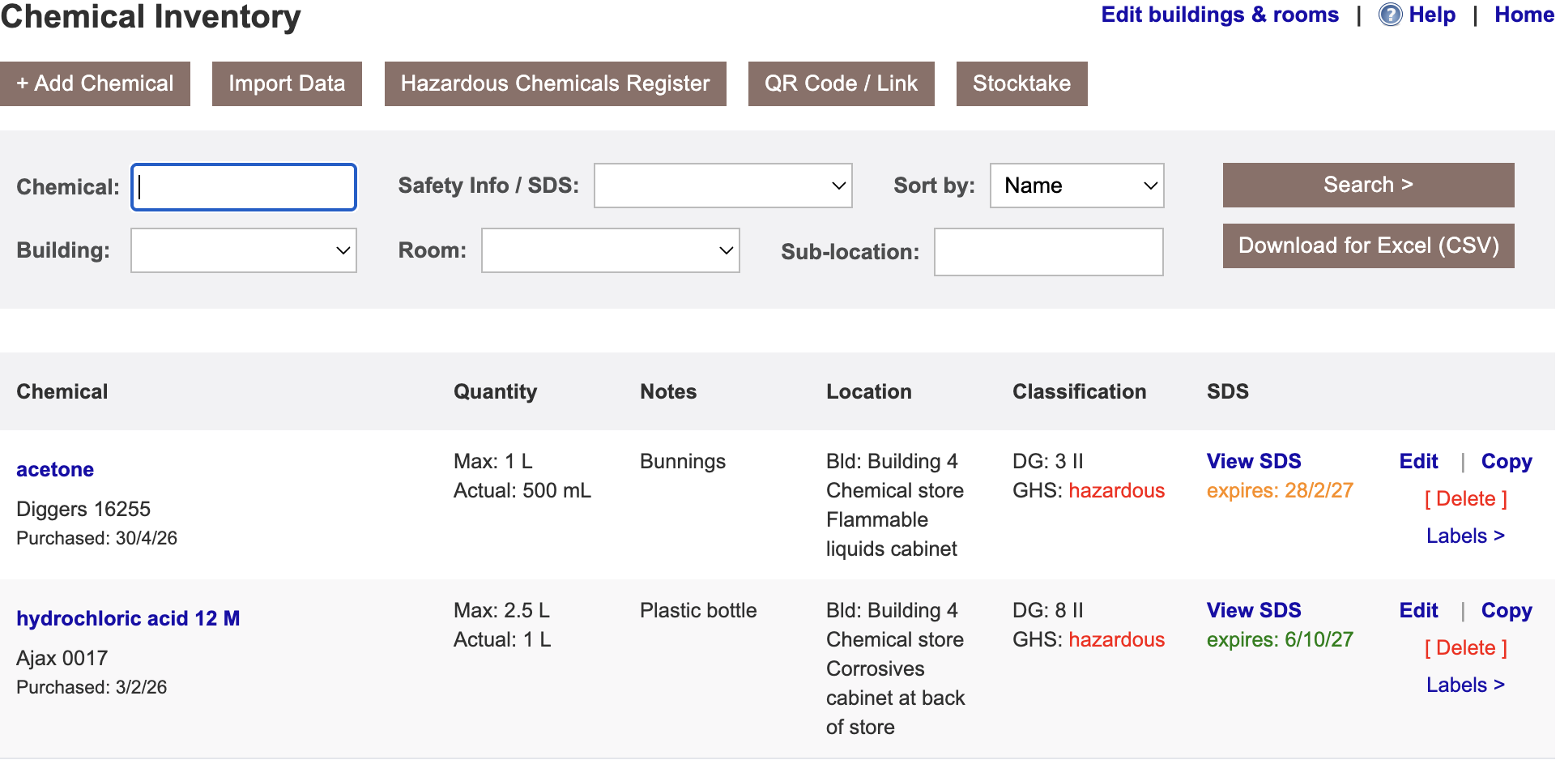

Slide 15
DEMO!
Storage guide
Overview of inventory & register
QR Codes
Adding a record
SDS management
Getting started: locations & enter OR import
Importing data
Stocktake
Help & download/backup

Slide 16
Questions?

