Slide 1
Introduction to RiskAssess
James Crisp

Slide 2
• reduce injuries • increase legal protection
Why do risk assessments?

Slide 3
Issues
facilities available
behaviour of the class
students with special needs
students with allergies
. . . . . . . .
Issues may, and commonly will,
differ from class to class.
No one hat fits all!

Slide 4
What is RiskAssess?
• web-based risk assessment tool
• customised to the school situation
• provides - electronic templates (AU/ISO) - databases of information on risks
• easy sharing of risk assessments
• plus ordering, scheduling & labelling

Slide 5
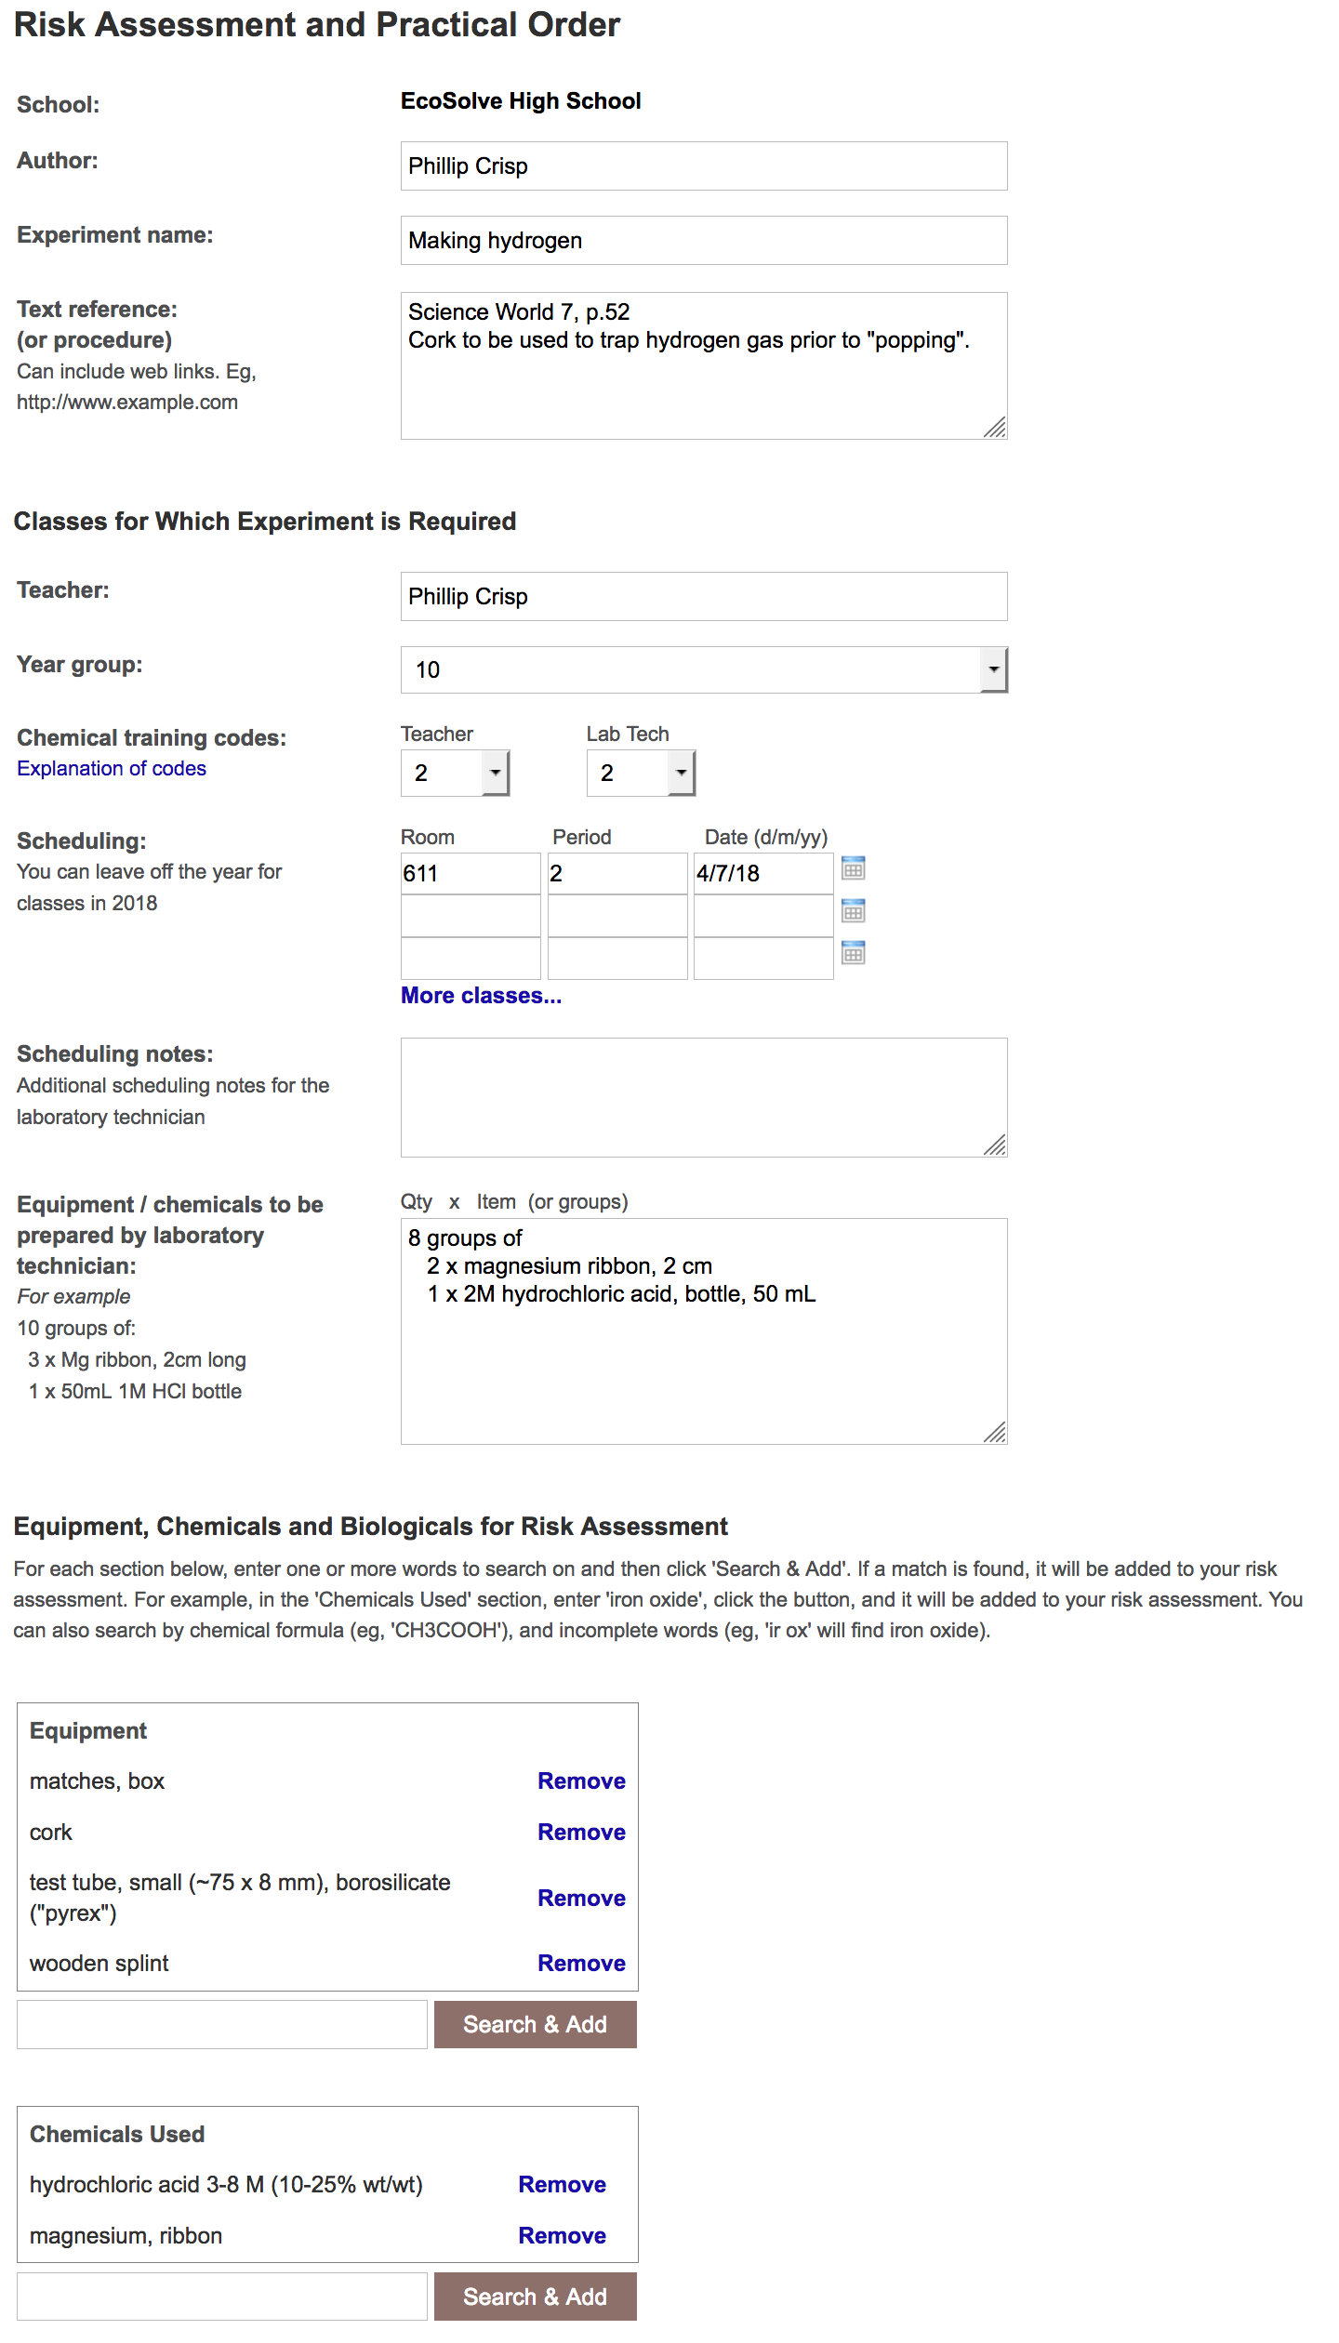
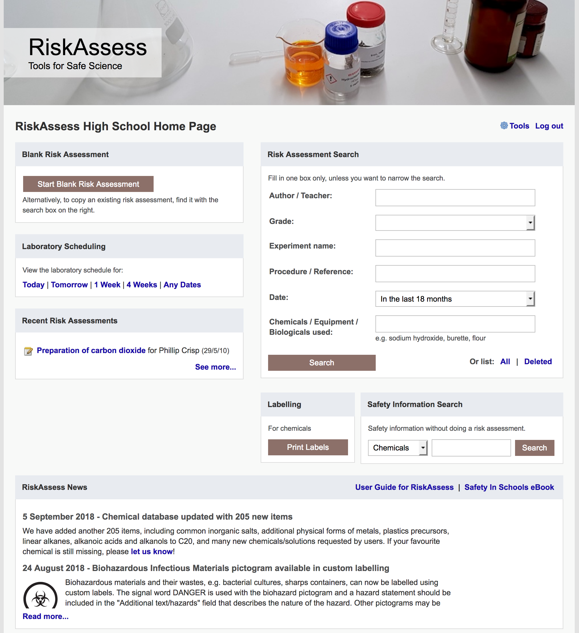

Slide 6
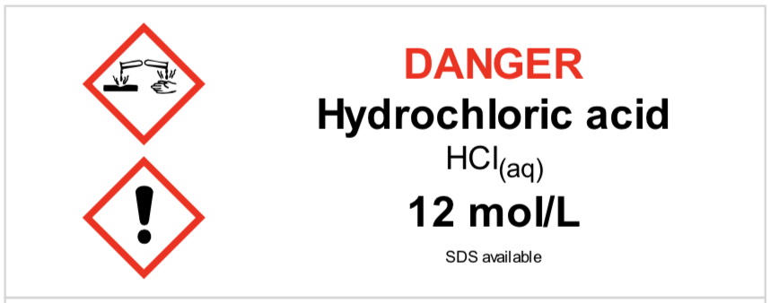
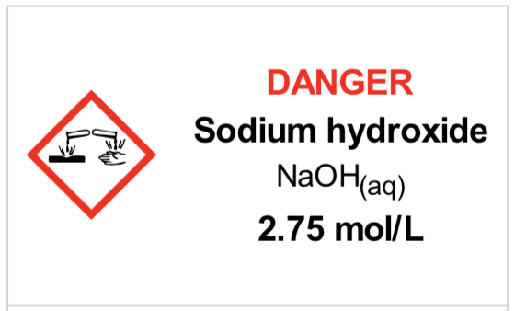
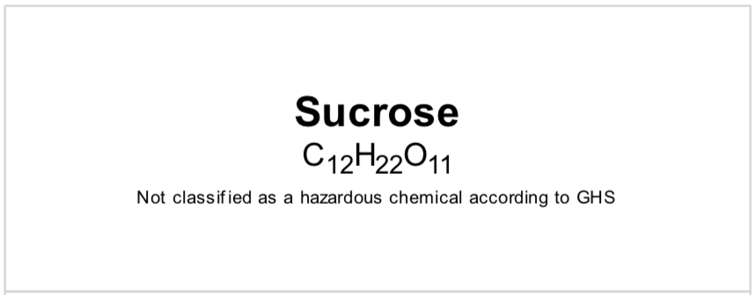
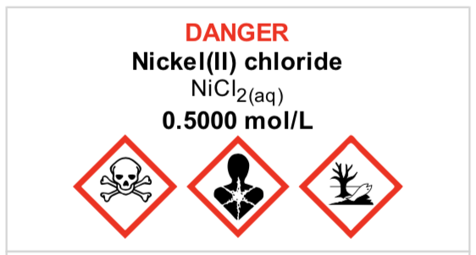
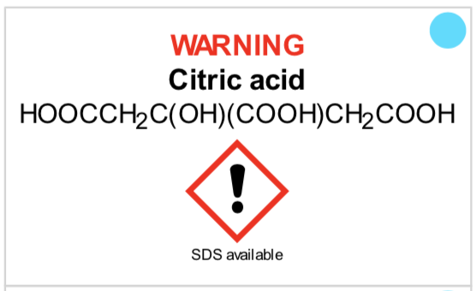
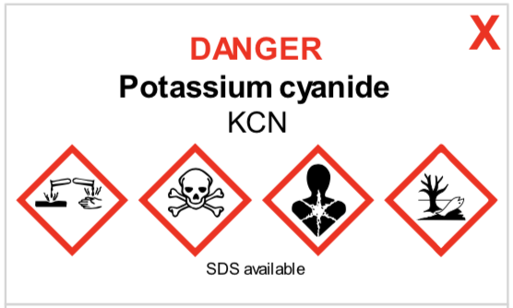
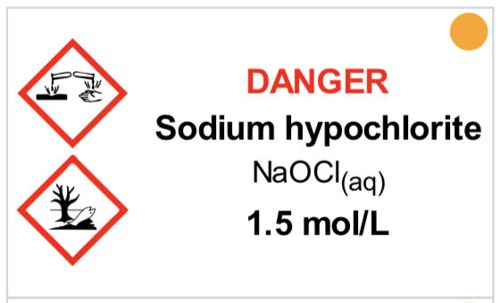
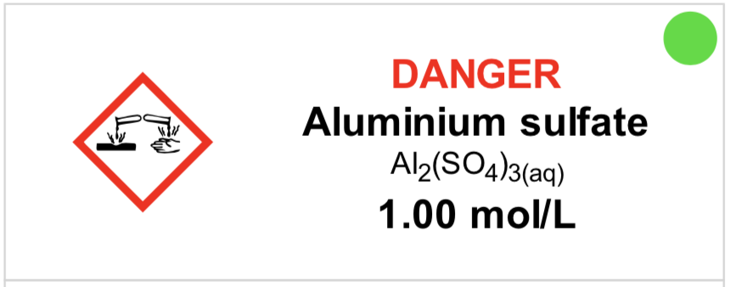
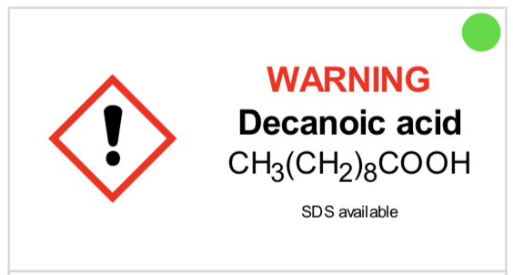
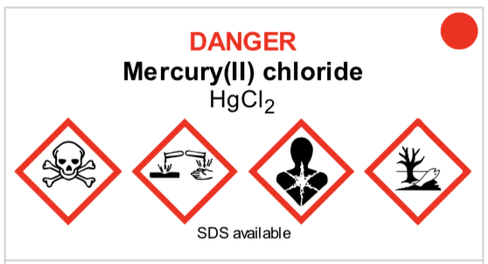
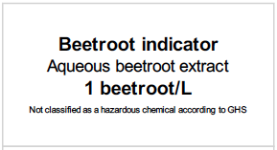
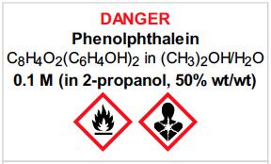

Slide 7
Logic
• separate sections for teacher and lab technician
• initial assessment of inherent risk - if low, go to end - if medium or more, record control measures - if high or extreme, third reviewer required
• cross-checking by teacher/tech/reviewer
• scheduling, ordering, labelling to save time
• inexpensive ($300+GST per campus per year)

Slide 8
Electronic system
• relatively rapid
• prompts sensitive to context
• reduces paper consumption
• easy to review and update
• search and statistics
• long term storage
• demonstrated to work in schools
RiskAssess: 2,700 schools AU+NZ+CA
80% AU, 82% Qld
6,500,000 risk assessments

Slide 9
Details
• access from school/home
• nothing to install on computer, tablet or phone (instant update)
• unlimited number of simultaneous users and risk assessments
• minimal data entry
• complements SDSs
• continuing input from science staff
• multiple backups of data & backup server
• support and advice

Slide 10
DEMO

Slide 11
Advantages of RiskAssess
proper consideration of risks and control measures
standardisation
storage of records for legal purposes
communication between teachers and lab technicians
discourages spur-of-the-moment experiments
useful for new/inexperienced staff

Slide 12
Even more!
• scheduling system
• prac ordering
• GHS labelling - standard - custom
• disposal advice
And an exciting video . . .
“Getting Started with RiskAssess”
starring Phillip and Eva!

Slide 13
Outcomes
• reduced frequency of injuries - to students - to school staff
• reduced costs for paperwork, litigation and payouts
• compliance with the law
• helps maintain variety of chemicals and equipment
• easy ordering, scheduling and labelling

Slide 14
2700 schools Qld: 451 (82%)
560 schools Qld: 200 (36%)
200 schools
Qld: 7
50 schools Qld: 13

Slide 15
Questions?

